Slide 1
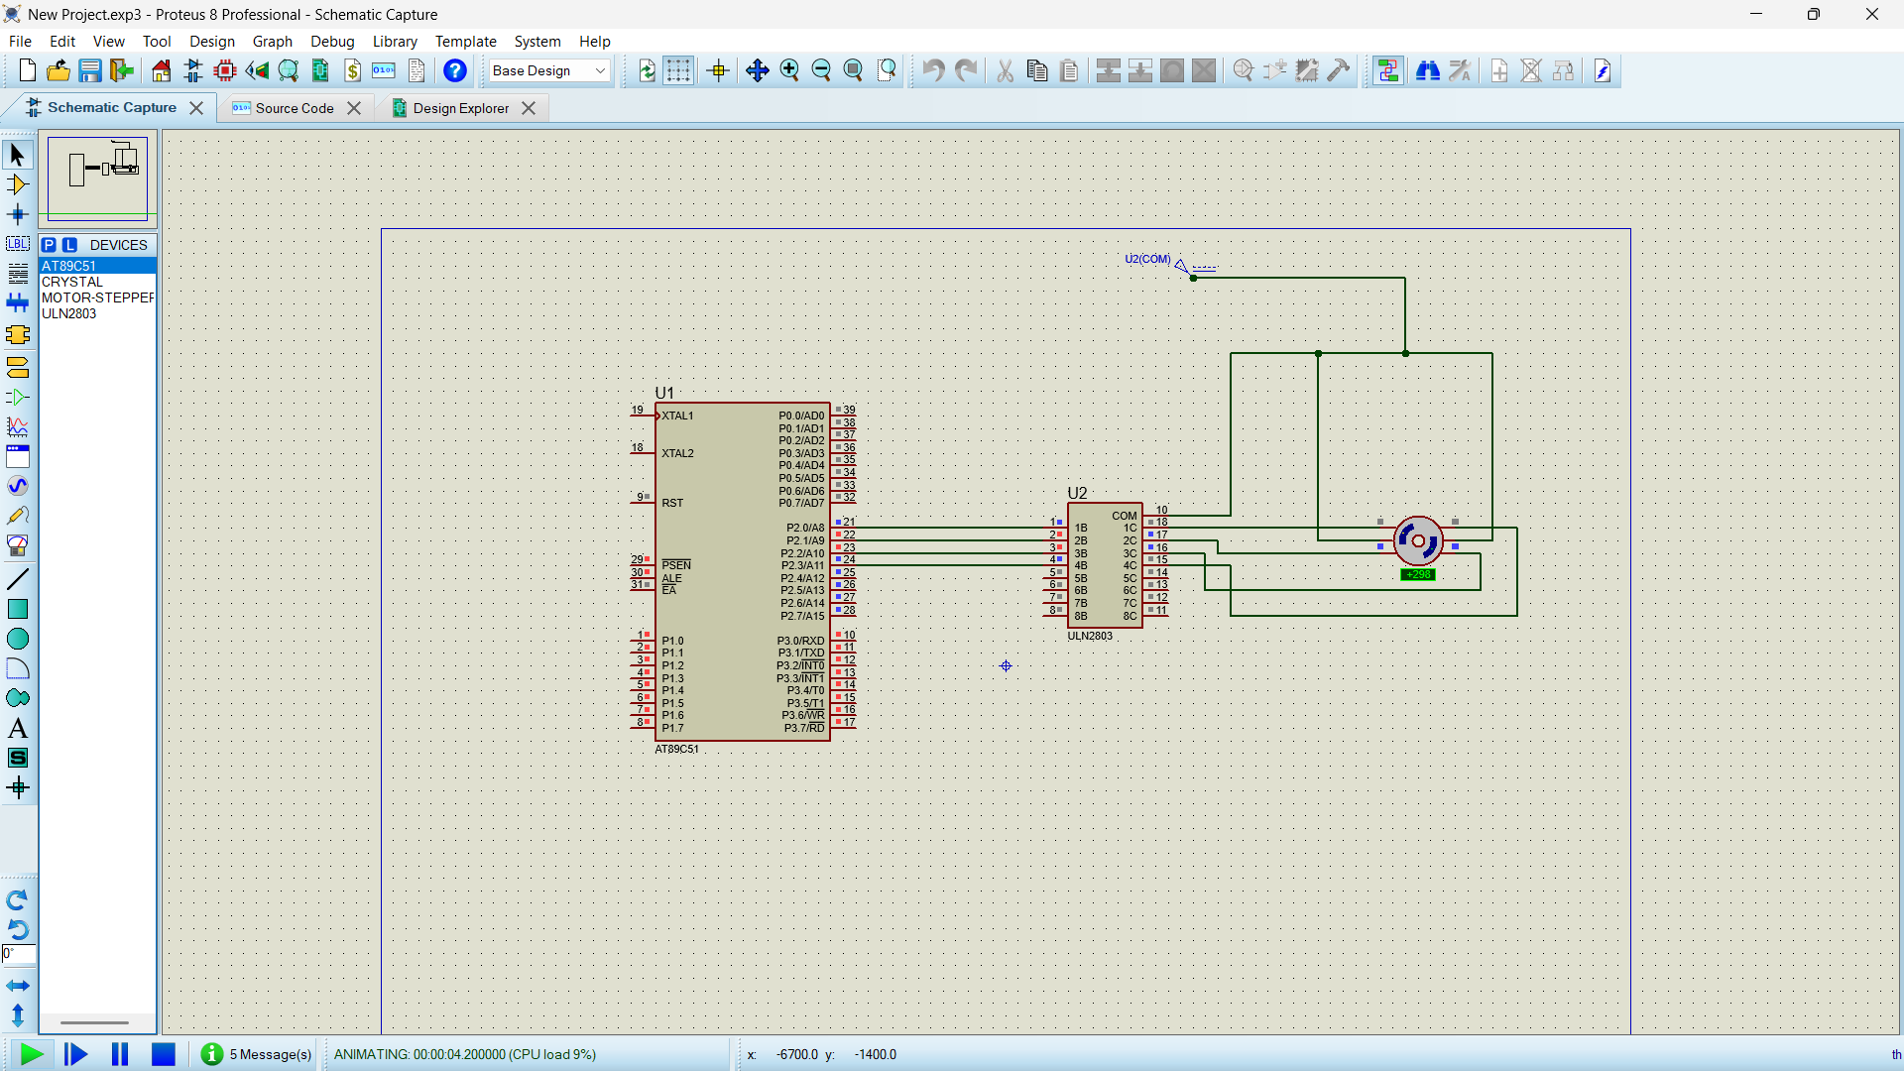
STEPPER MOTOR USING AT89C51 USING PROTEUS
Objectives
To generate a square wave using AT89C51
To study sleeping sequence of a stepper motor
To control rotational movement using assembly language
CIRCUIT DIAGRAM
PROGRAM
ORG 0000H
UP: MOV P2,#09H
ACALL DELAY
MOV P2,#0CH
ACALL DELAY
MOV P2,#06H
ACALL DELAY
MOV P2,#03H
ACALL DELAY
SJMP UP
DELAY:MOV R4,#18
H1:MOV R3,#255
H2:DJNZ R3,H2
DJNZ R4,H1
RET
END

